Slide 1
How to Win Friends & Influence Your Third-Parties
2025 Supply Chain Vulnerability Report
Navigating a New Era of Managing Vulnerability Risk in Third Parties

Slide 2
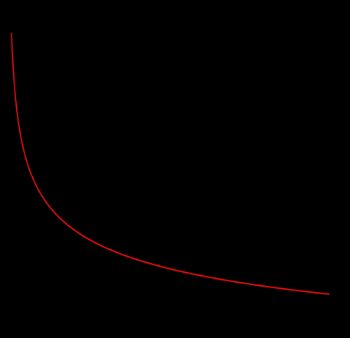
Cost to Remediate an Enterprise-wide Vulnerability
Cost Component | Cost |  | Notes
 | Low | High
Vulnerability Discovery | $ 500 | $ 5,000 | Includes scanning tools, analyst review, etc.
Remediation Effort | $ 2,000 | $ 25,000 | Developer/sysadmin/engineer time to fix
Testing & Validation | $ 1,000 | $ 10,000 | QA, regression testing, UAT
Change Management / Comms | $ 500 | $ 3,000 | Meetings, approvals, documentation
Downtime / Business Impact | $ 0 | $ 50,000 | Varies dramatically by environment
Compliance Reporting | $ 500 | $ 5,000 | Required if regulated or public
TOTAL | $4,500 | $98,000
Cost of Remediation ($ Log Scale)
4,500 98,000
$5,500
Sources
Ponemon Institute Study (2019); Dark Reading (2009); Opus Security Guide (2023); Neumetric; Rapid7; Rapidfort; Cyentia; The Pi-Guy; Black Kite BRITE
1st 2nd 3rd 4th 5th
Quintiles

Slide 3
Moving from Identification to Action
CVE
Common Vulnerabilities and Exposures
A dictionary or catalog of publicly known cybersecurity vulnerabilities
WHAT IT IS
CVSS
Common Vulnerability Scoring System
A standardized scoring system for assessing the severity of vulnerabilities
HOW BAD IT IS
EPSS
Exploit Prediction Scoring System
An estimate of the likelihood that a given software vulnerability will be exploited
HOW LIKLEY IT IS
KEV
Known Exploited Vulnerabilities
A catalog of vulnerabilities that have been confirmed as actively exploited in the wild.
IT IS BEING EXPLOITED
Black Kite Risk Intelligence
A risk-based aggregate of the above combined with Black Kite Research helps narrow the scope to real, likely, dangerous, impactful, scalable to focus resources on the most ‘important’ exposures to address
WHAT NEEDS TO BE FIXED

Slide 4

Barrier to Collaboration
Wow, this stuff is expensive to fix
100
EPSS %
80
Assumptions
470 open enterprise-wide vulnerabilities per Third-Party
Cost to Remediate ~$5,500 per enterprise-wide vulnerability
Cost - $2,585,000
That’s a big ask
60
CVSS
40
20
0
2.0
0
1.0
3.0
4.0
5.0
6.0
7.0
8.0
9.0
10.0

Slide 5
How Can Black Kite Help?
How Can Black Kite Help?
First let’s get rid of CVSS < 6.0
Aka the ones that aren’t dangerous
100
EPSS %
80
New Assumptions
250 open enterprise-wide vulnerabilities per Third-Party
Cost to Remediate ~$5,500 per enterprise-wide vulnerability
Cost - $1,375,000
Better, but not good enough
60
CVSS
40
20
0
2.0
0
1.0
3.0
4.0
5.0
6.0
7.0
8.0
9.0
10.0

Slide 6
How Can Black Kite Help?
How Can Black Kite Help?
Now let’s get rid of EPSS < 60%
Aka the ones that aren’t that likely
100
EPSS %
80
New Assumptions
120 open enterprise-wide vulnerabilities per Third-Party
Cost to Remediate ~$5,500 per enterprise-wide vulnerability
Cost - $660,000
Better still, but still not good enough
60
CVSS
40
20
0
2.0
0
1.0
3.0
4.0
5.0
6.0
7.0
8.0
9.0
10.0

Slide 7
How Can Black Kite Help?
How Can Black Kite Help?
Now focus on KEVs
Aka the ones the that are ‘real’
100
EPSS %
80
New Assumptions
50 open enterprise-wide vulnerabilities per Third-Party
Cost to Remediate ~$5,500 per enterprise-wide vulnerability
Cost - $275,000
Even better still, but still not good enough
60
CVSS
40
20
0
2.0
0
1.0
3.0
4.0
5.0
6.0
7.0
8.0
9.0
10.0
*

Slide 8
How Can Black Kite Help?
Finally, let’s apply Black Kite’s Intelligence
Aka the real/dangerous ones that YOU care about
100
EPSS %
80
Final Assumptions
25 open enterprise-wide vulnerabilities per Third-Party
Cost to Remediate ~$3,500 * per enterprise-wide vulnerability*
Cost - $87,500
Winner, winner … chicken dinner
60
CVSS
40
20
0
2.0
0
1.0
3.0
4.0
5.0
6.0
7.0
8.0
9.0
10.0
* Black Kite’s Risk Intelligence combined with the Black Kite BridgeTM lowers the cost of vulnerability discovery and workflow/communication

